Slide 1

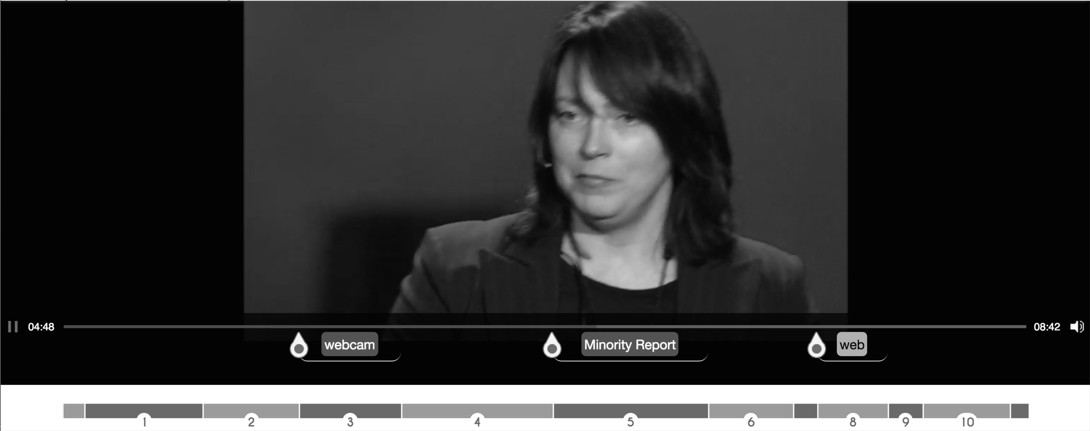
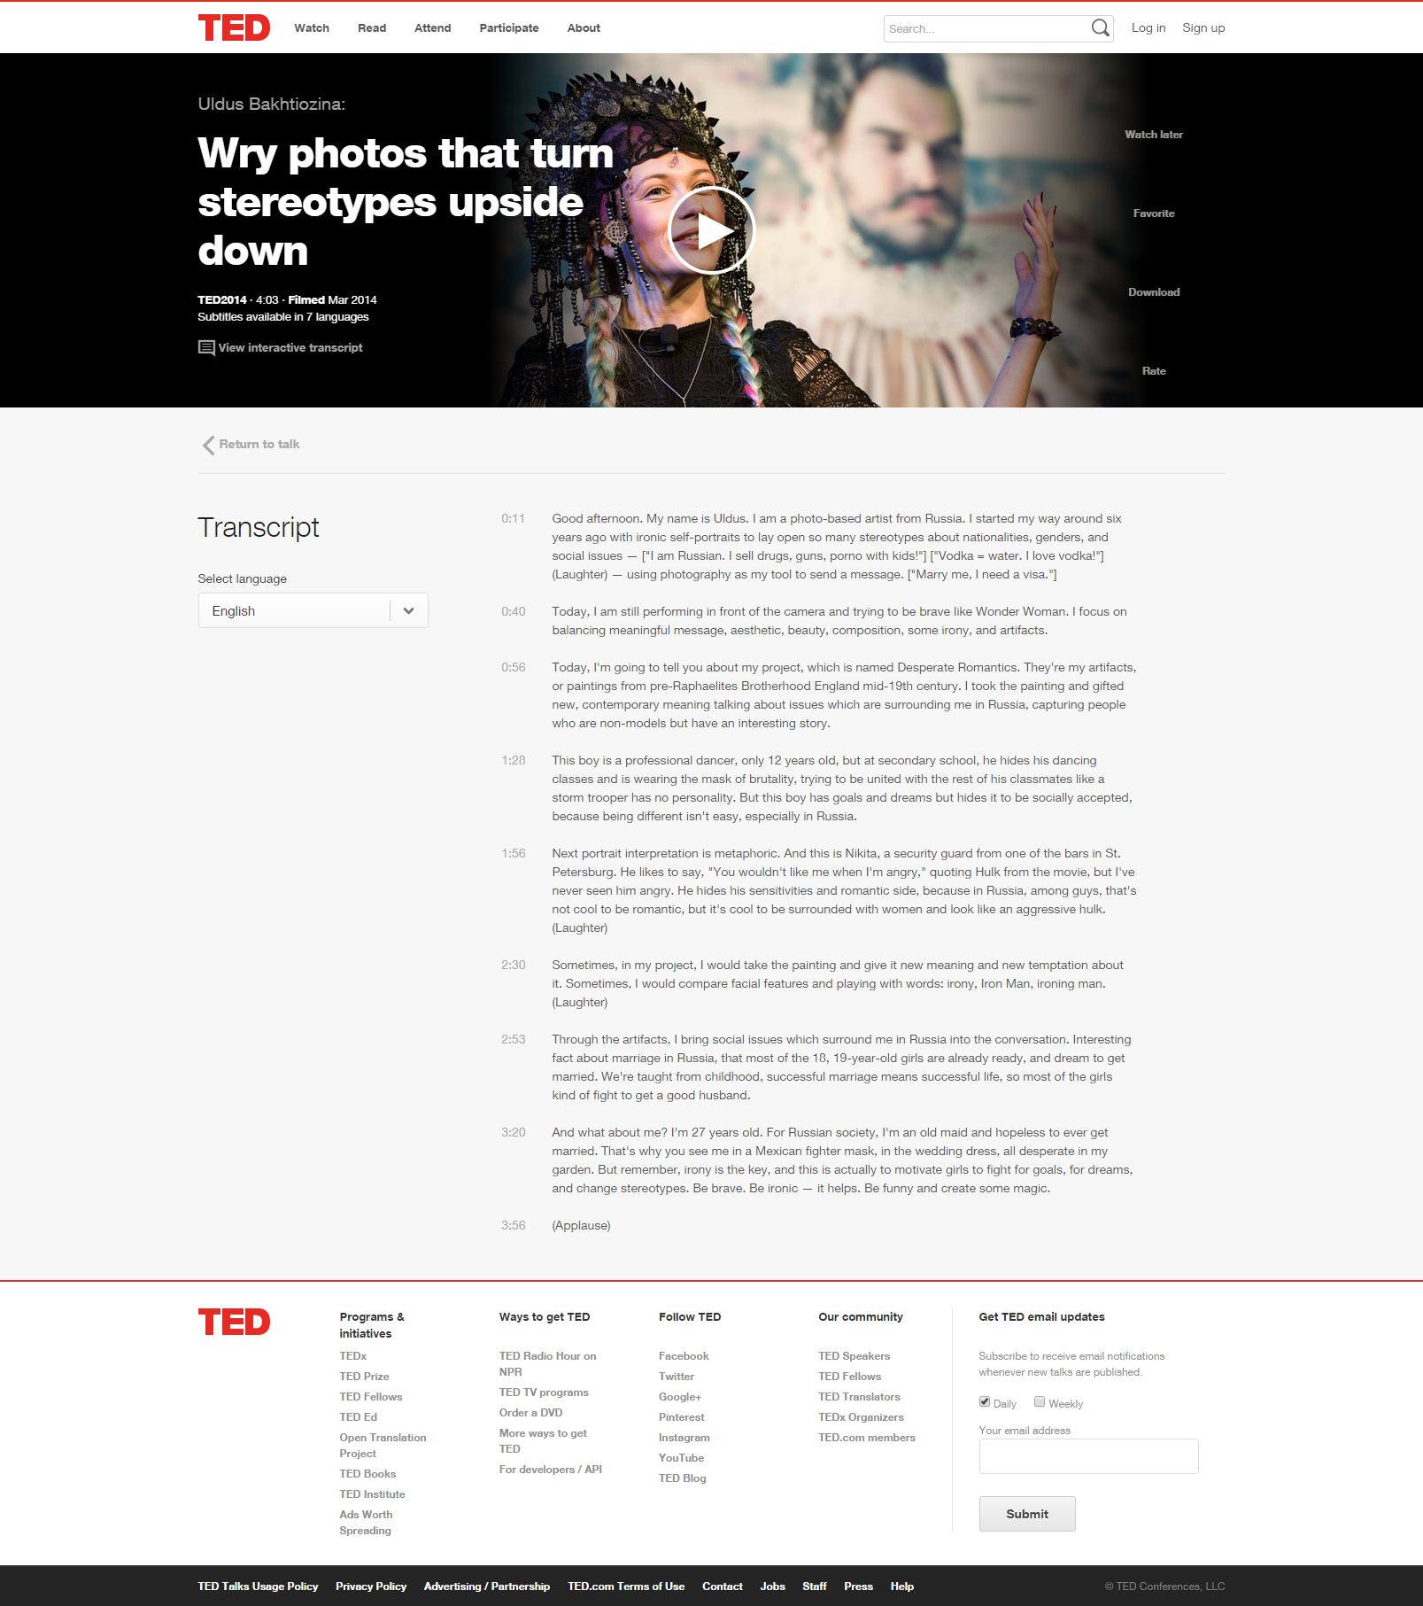


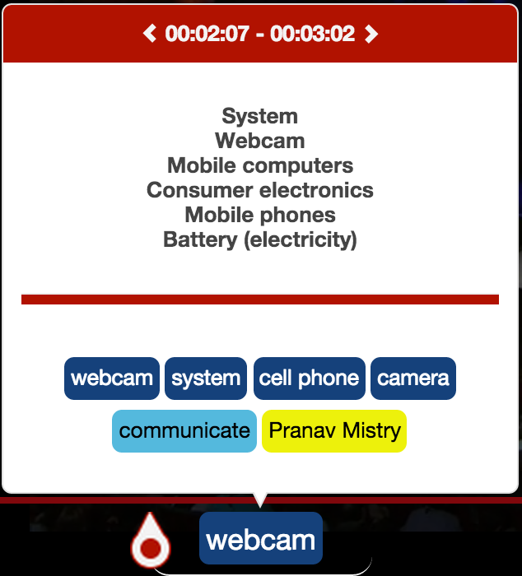
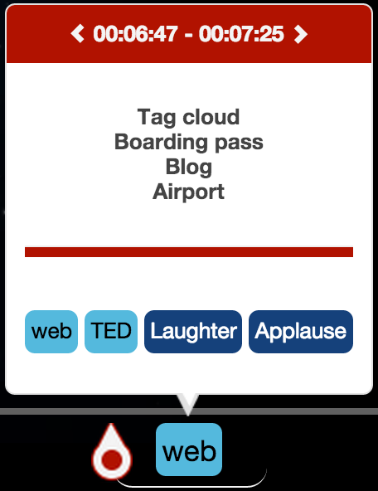
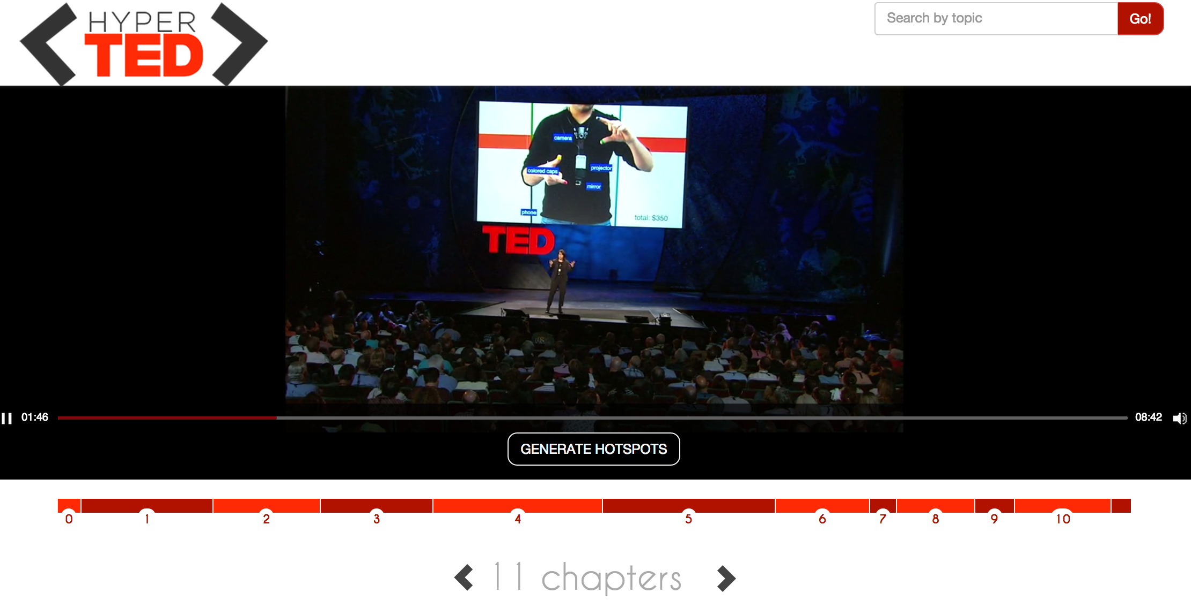

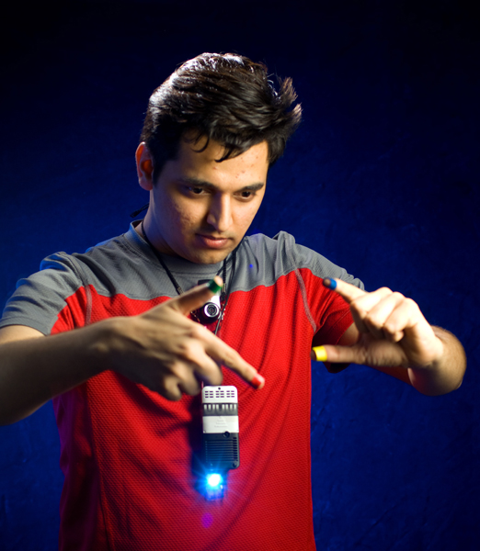
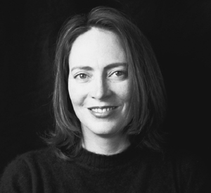


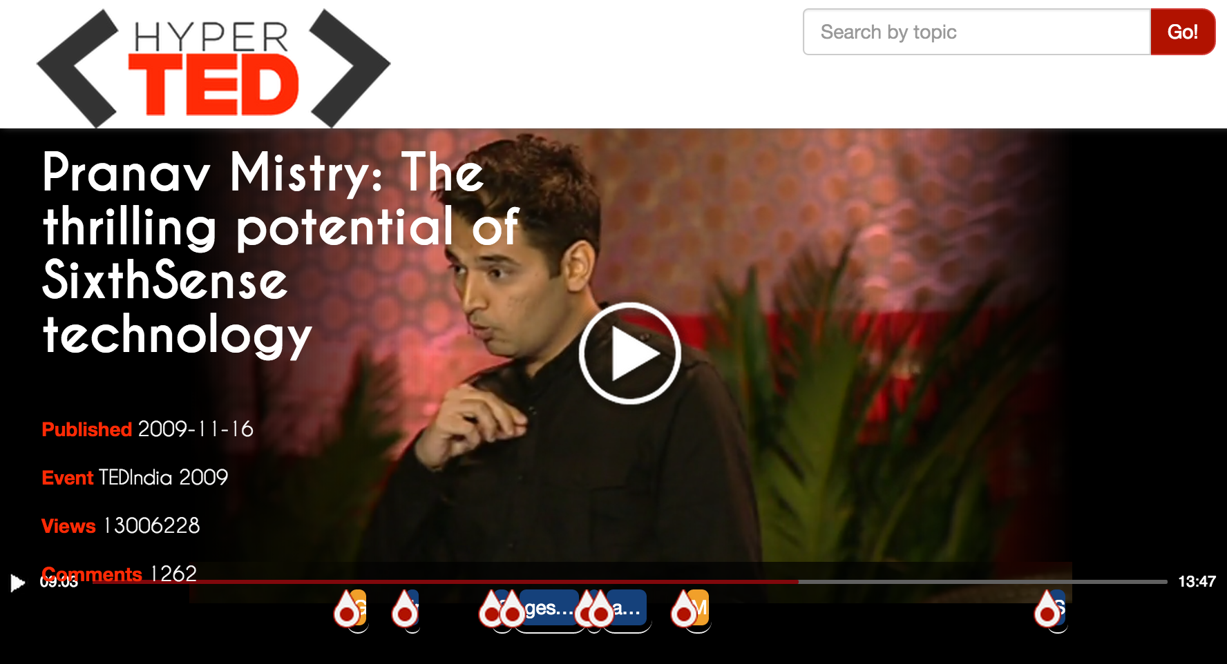
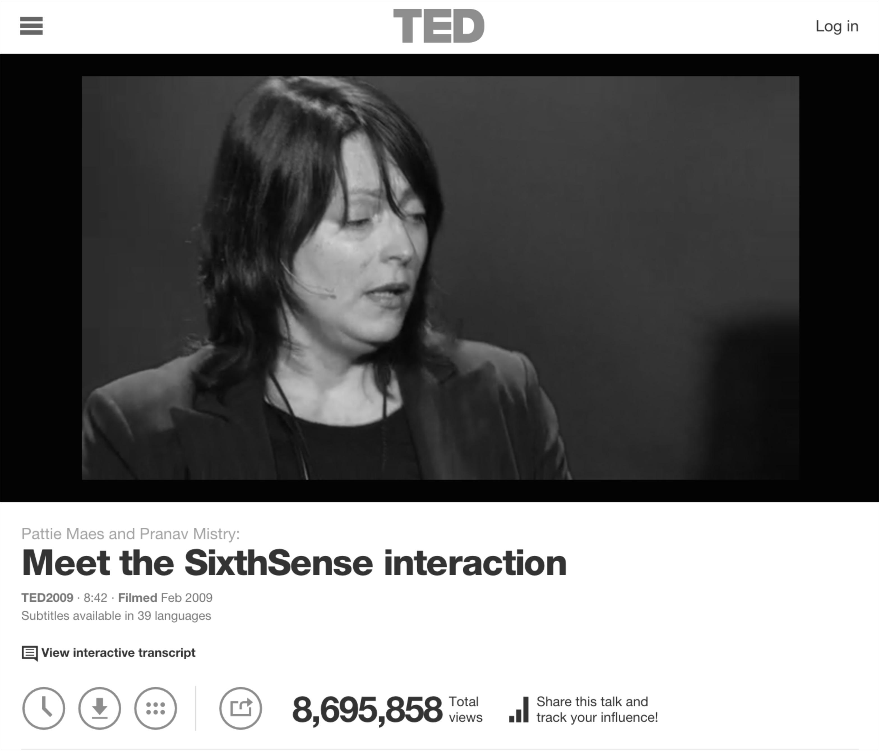






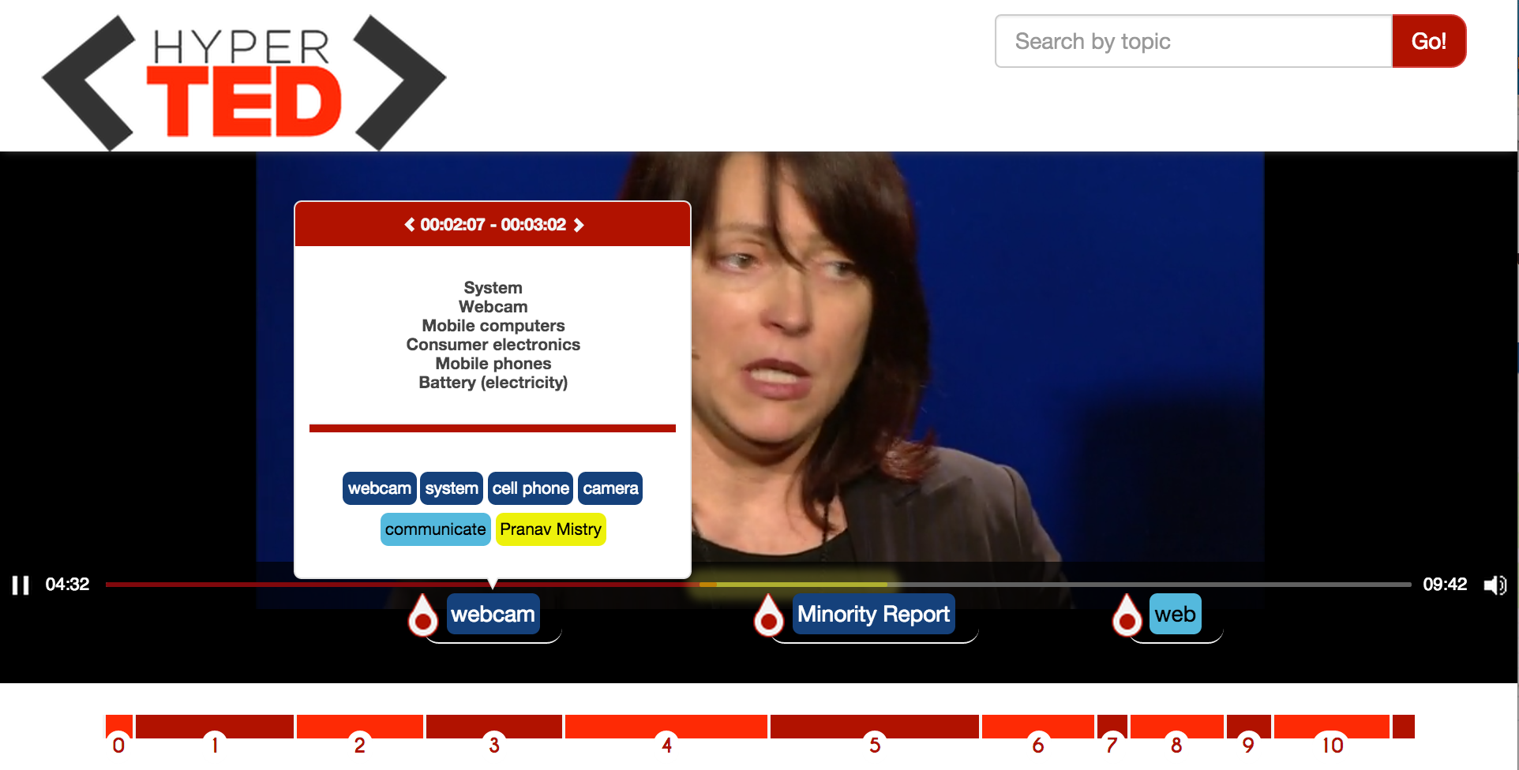
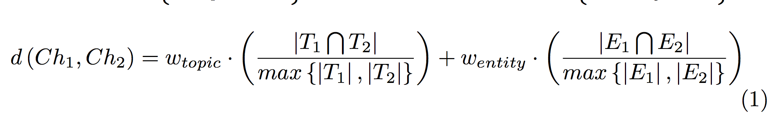
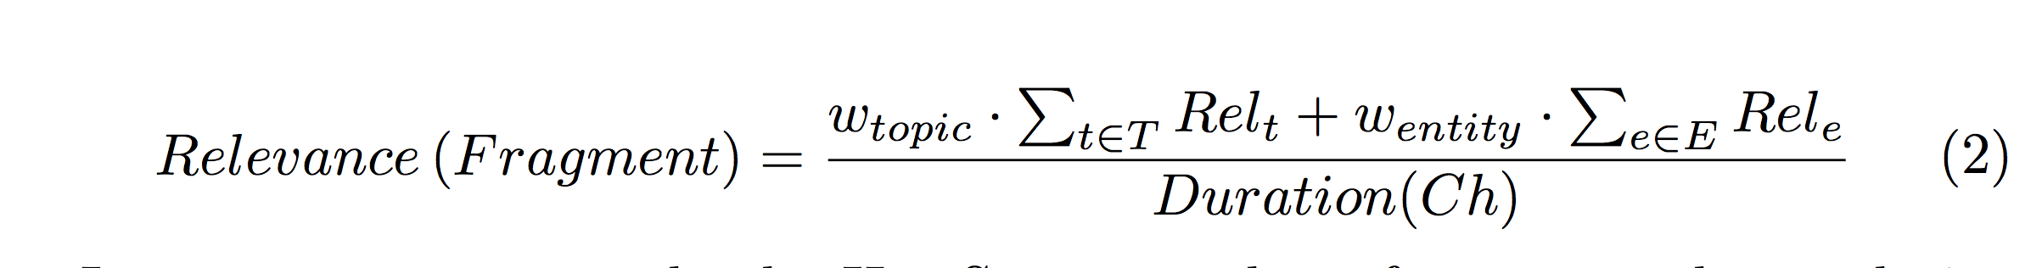
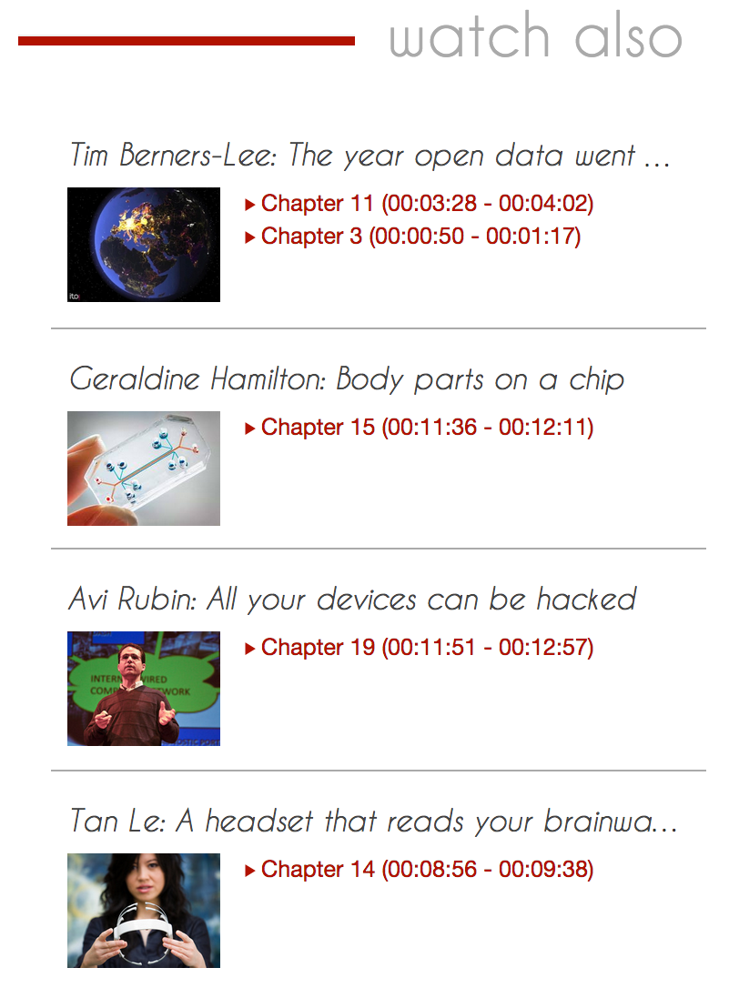
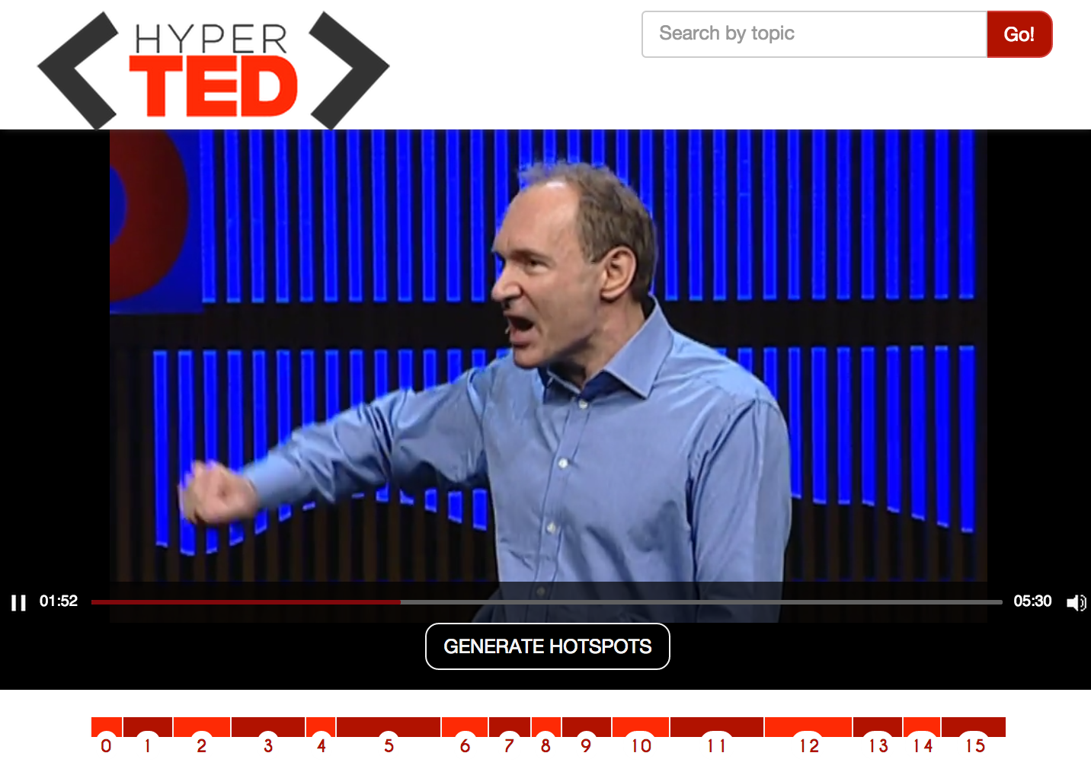
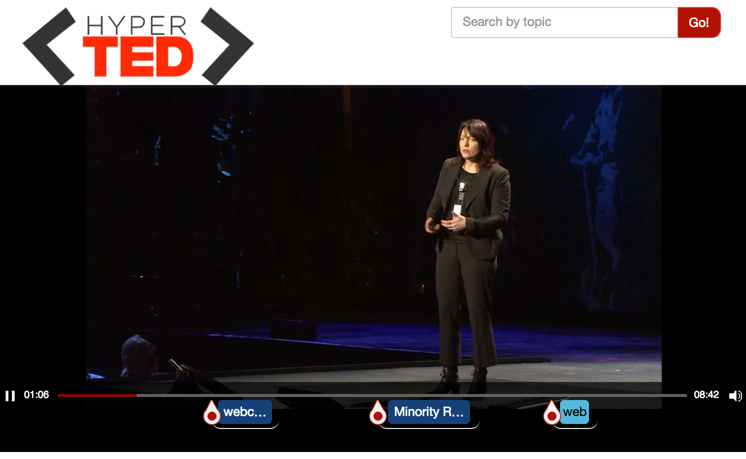
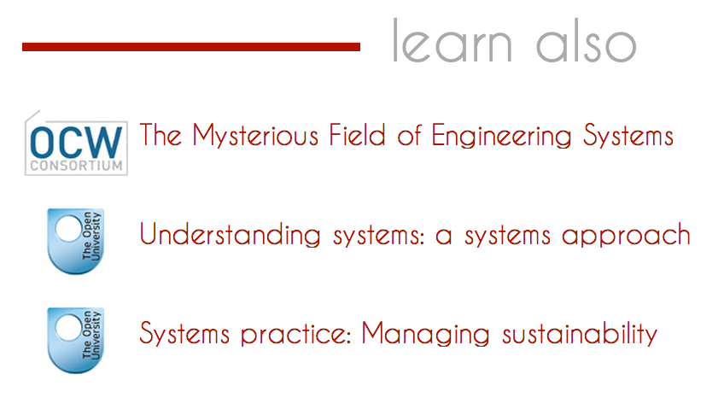



Searching and browsing TED Talks
José Luis Redondo García, Mariella Sabatino, Pasquale Lisena, Raphaël Troncy
{redondo, mariella.sabatino, pasquale.lisena, raphael.troncy}@eurecom.fr
HyperTED: empowering TED Talks
Annotating Media Fragments
2014
TED Talks paragraphs: a human-made subdivision of subtitles
Hot spots
TED CHAPTERS
Chapters
Related Ted’s Chapters
Entities
2006
.com
Understanding environment:
A system approach
The Mysterious Field of Engineering Systems
Courses
(1) Named Entities
(2) Topics
1984
Systems practice: Managing sustainability
“This is Nikita, a security guard from one of the bars in St. Petersburg.”
“I'm wearing a camera, just a simple webcam, a portable, battery-powered projection system with a little mirror. These components communicate…
“This is Nikita, a security guard from one of the bars in St. Petersburg.”
Battery (electricity)
Mobile computers
Consumer Ele..
Hot Spots: highlighting important fragments
Clustering of consecutive chapters which are about similar topics and entities
Ordering of those fragments based on annotation relevance (TF-IDF)
Filtering the fragments whose relative relevance falls under the first quarter
Hyperlinking: TED Chapters
Hyperlinking: Online Courses
Features Indexed:
Granularity level:
Datasets:
Anchors in search:
Attributes in search:
Topics
Entities
timing references (startNPT and endNPT)
Extractor confidence
Full text transcript
Chapter
Open Courseware
Open University
Entities Too specific
Topics Courses’ thematic
Title
Description
Subject, thematic…
Feeding TV Application
References
[1] Y. Li, G. Rizzo, J. L. R. García, R. Troncy, M. Wald, and G. Wills. Enriching Media Fragments with Named Entities for Video Classification. In 1st Worldwide Web Workshop on Linked Media (LiME’13), pages 469–476, Rio de Janeiro, Brazil, 2013.
[2] J. L. R. García, M. Hildebrand, L. Perez Romero and R. Troncy. Augmenting TV Newscasts via Entity Expansion. In Demonstration Track of Extended Semantic Web Conference (ESWC), Crete, Greece, May 2014
Notes:
Base pour concevoir votre poster EURECOM.
Le service COM est à votre disposition pour toute aide complémentaire

